Slide 1


PicPro – A Cloud-based Image Transformation Application
Matthias Eder (11378093) and Eric Zhang (10319191)
CAB432 Cloud Computing 2022
Queensland University of Technology

Slide 2
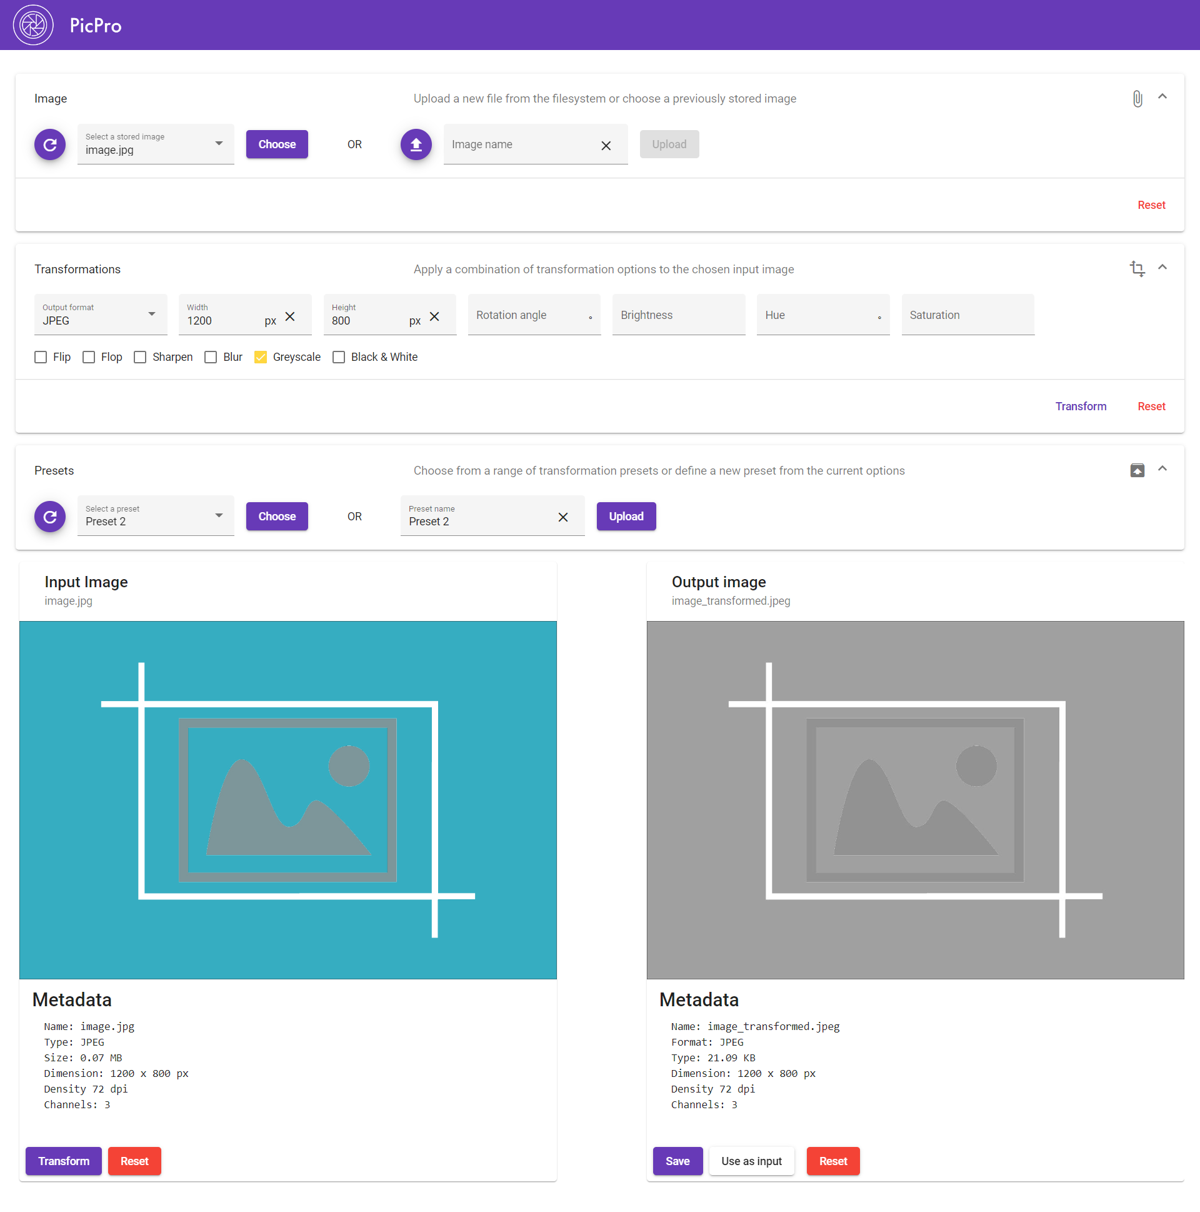
The App
Transform images by changing the filetype format, resizing the image, or adding effects like blur, greyscale, etc.
Allows new and transformed images to be stored in S3 to be always accessible
Saves presets for transformations to ElastiCache for Redis to re-use common transformations

Slide 3
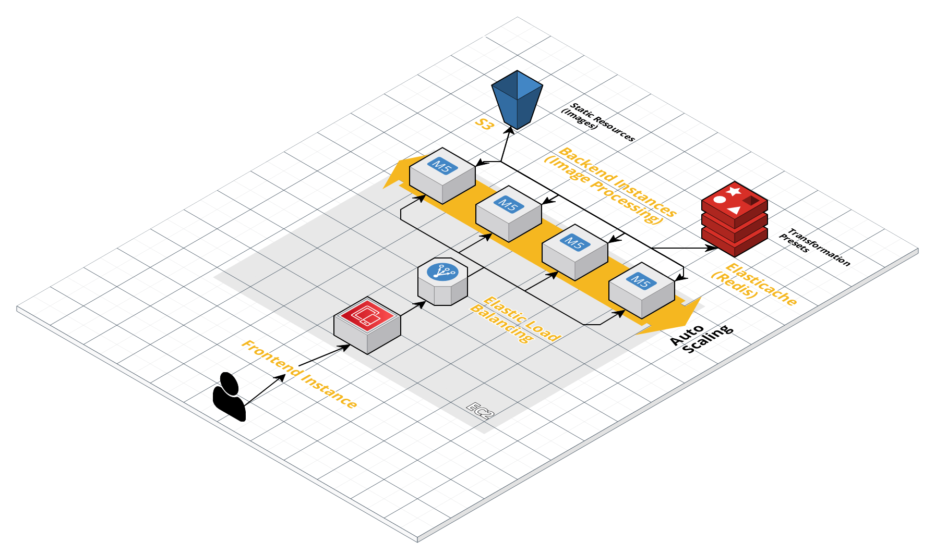
The Architecture

Slide 4
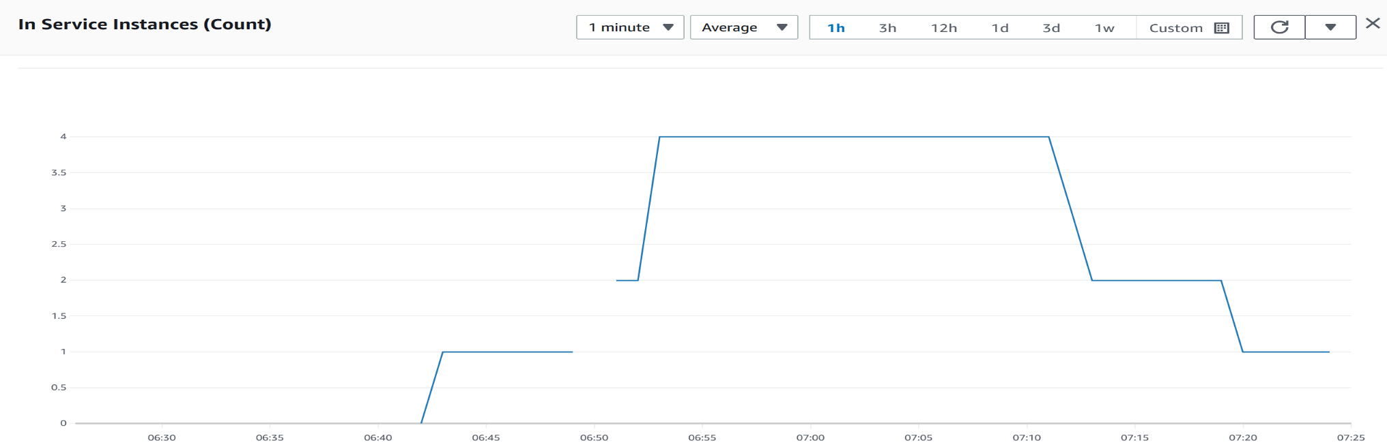
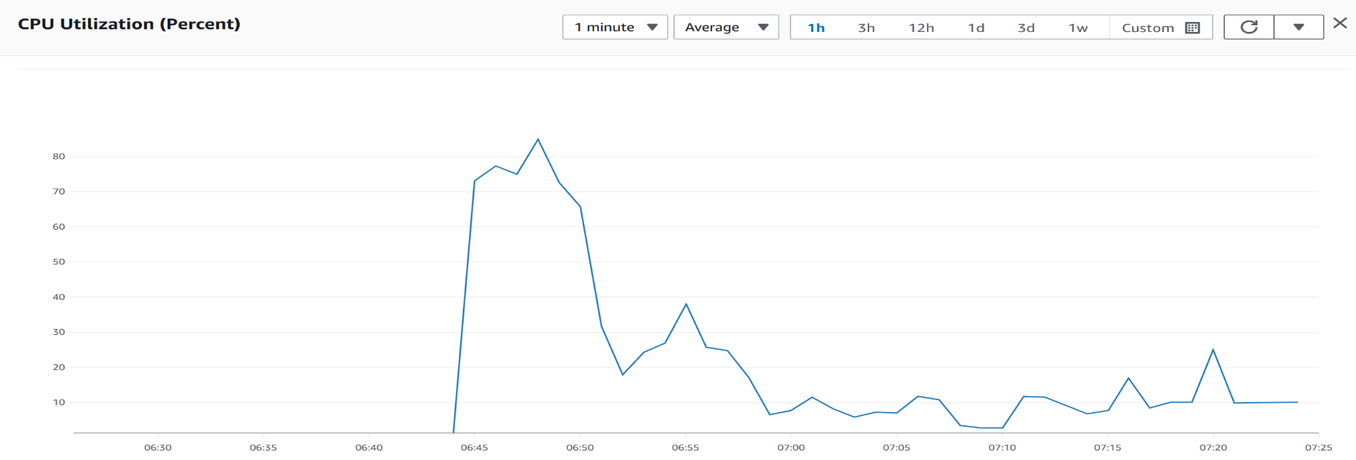
Scaling/Performance
To Be Replaced

